Slide 1
LIVING A LIFE FULLNESS IN SPIRITWALKING IN THE SPIRIT
GALATIANS 5:16-25

Slide 2

WALKING IN THE SPIRIT

Slide 3
TO WHOM WAS PAUL WRITING?
Galatians was written from Antioch in A.D 49 to churches that Paul founded on his first missionary journey (Acts 13-14).
(Pisidian) Antioch
Iconium
Lystra
Derbe

Slide 4
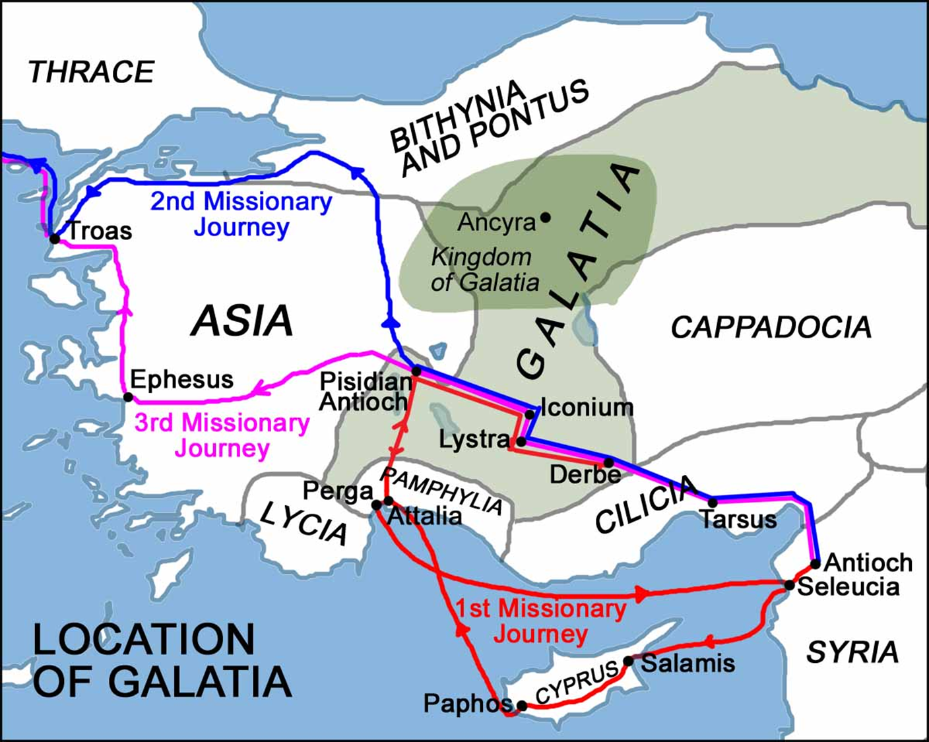
TO WHOM WAS PAUL WRITING?

Slide 5
CHRIST’S SUMMARY OF THE LAW
“Love the Lord your God with all your heart, soul, mind and strength” and “Love your neighbor as yourself” (Matthew 22:34–40)-provides the goal of the Christian life, then what provides the motivation and strength to do it?

Slide 6

PAUL’S ANSWER
Live by the power available through the Holy Spirit.

Slide 7
PERSONAL SPIRITUAL LIVES
Paul warned the Galatians about following their own wishes and desires.
Slavery was a threat from the outside influence of the false teachers, but it was an equal threat from the inside desires of the flesh.

Slide 8
PAUL WARNED THEM
Paul began with the warning in 5:13, “Do not use your freedom to indulge the sinful nature” (NIV), and he immediately contrasted it with the second part of Christ’s summary of the law, “Serve one another in love” (NIV).

Slide 9
LESSONS
Paul wanted them to replace self-indulgence with loving service to others.
Paul explained that the secret to loving our neighbor as ourselves is by living in the Spirit and not giving in to our sinful human desires

Slide 10
GALATIANS 5:16 NIV
So I say, live by the Spirit, and you will not gratify the desires of the sinful nature.
The word so ties in with verses 13–15. The strategy for removing the divisiveness that marred the Galatian church was to serve one another in love, but that too was humanly impossible.

Slide 11
LESSON
People cannot, in their own power, show love to all people at all times. But God has provided the means to meet his commands—the Holy Spirit.

Slide 12
THE HOLY SPIRIT
God sent the Holy Spirit to be with and within his followers after Christ had returned to heaven.
The Spirit would comfort them, guide them to know his truth, remind them of Jesus’ words, point out when they did not obey, give them the right words to say, and fill them with power to do good (Ref: John 14–16).

Slide 13
AT PENTECOST (ACTS 2:1-4)
God made the Holy Spirit available to all who believed in Jesus. We receive the Holy Spirit (are baptized with him) when we believe in Jesus Christ as Savior.

Slide 14
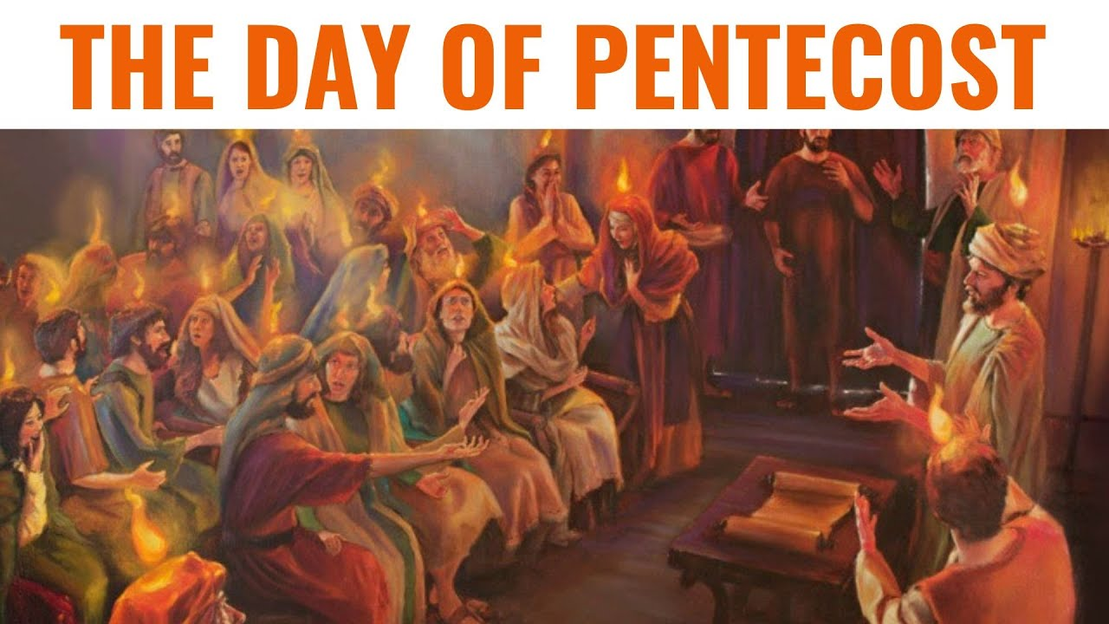
THE DAY OF PENTECOST

Slide 15
LESSON
We must understand the baptism of the Holy Spirit in the light of his total work in Christians.

Slide 16
WORK OF THE SPIRIT
The Spirit marks the beginning of the Christian experience (Ephesians 1:13–14).

Slide 17
WORK OF THE SPIRIT
II. The Spirit provides power
for our new lives.
He begins a lifelong
process to make us more
like Christ (2 Cor. 3:17–18).

Slide 18
WORK OF THE SPIRIT
III. The Spirit unites the Christian
community in Christ
(Ephesians 2:19–22).
The Holy Spirit can be
experienced by all, and he works
through all
(1Cor. 12:11; Ephesians 4:4).

Slide 19
THE PHRASE LIVE BY THE SPIRIT
(PNEUMATI PERIPATEITE)
Conveys the meaning of the literal translation “by the Spirit keep on walking.”

Slide 20
WALKING
Walking means “living” in this context, and it emphasizes the moment-by-moment contact with and guidance by the Holy Spirit for daily decisions and activities.

Slide 21
LIVING “BY THE SPIRIT”
Living “by the Spirit” should be a daily, continuous action by Christians.
He is always present, but we must be in touch with him and stay open to his guidance and correction.

Slide 22
WE LIVE THE CHRISTIAN
LIFE “BY THE SPIRIT”.
Meaning that he gives us the power we need to follow God when his will goes against our nature or desires.

Slide 23
PHILIPPIANS 2:13
“it is God who works in you to will and to act according to his good purpose”
Expressed negatively, we cannot live the Christian life without the Holy Spirit. Expressed positively, we experience the truth that

Slide 24
IMPLICATION
The tense of the verb is present continuous action, so it conveys “keep on living” or “keep on walking” by the Spirit, portraying the Christian life as a process.

Slide 25
REMEMBER
We do not obtain salvation by works; neither can we obtain sanctification (growing in the Christian life) by works.

Slide 26
THE RESULT OF WALKING
IN SPIRIT
You will not gratify the desires of the sinful nature. When we become believers, our sinful nature still exists. But God asks us to place our sinful nature under the control of the Holy Spirit so that he can transform it.

Slide 27
NOTE 1
This is a supernatural process. We must never underestimate the power of our sinful nature, and we must never attempt to fight it in our own strength. Satan is a crafty tempter, and we have a limitless ability to make excuses.

Slide 28
NOTE 2
Instead of trying to overcome sin by our own willpower, we must take advantage of the tremendous power of Christ. God provides for victory over our sinful nature—he sends the Holy Spirit to live in us and give us power.

Slide 29
NOTE 3
But our ability to restrain the desires of the sinful nature depends on how much we’re willing to “live by” the Holy Spirit. For each believer, this daily process requires moment-by-moment decisions.

Slide 30
LESSON
Living “by the Holy Spirit” means that we submit to his authority, welcome his guidance, accept his correction, live under his restraint, rely on his power, and allow him to unify us with other believers.

Slide 31
CONCLUSION
Living by the Spirit does not mean a casual part-time relationship. We must treat his control like a shower. If we stand back and stick a hand or foot into the stream of water, we may guess the temperature of the water, but we will never get clean. We must be immersed in the Holy Spirit as if stepping fully into the shower’s cleansing and invigorating stream, letting it cover us.

Slide 32
Prepared by
Rev. Gad Mugisa
Asian center for Theological studies and Mission, Yangpyeong-South Korea.
Mobile No: +82-10-4044-3205
Email: mugisagad@gmail.com
Twitter: @GadMugisa38
Skype: mugisagad

